Slide 1
Angular Routing
Styling, Animating and Watching Routes
Lecture 7
By James(Jin) Wang
12/26/2021

Slide 2
Outline
Styling the Selected Route
Animating Route Transitions
Watching Routing Events
Reacting to Routing Events

Slide 3
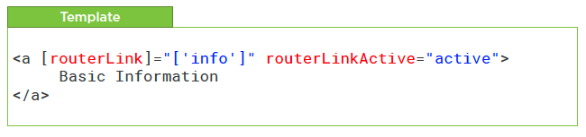
Styling Selected Route
  Styling the Selected Route
  Demo: style selected route

Slide 4
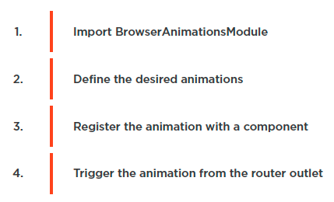
Styling Selected Route
  Animating Route Transitions
  Demo: animate route transition

Slide 5
Summary

Slide 6
Assignment

Slide 7
Self Study
  Angular Routing
  https://app.pluralsight.com/library/courses/angular-routing

